Slide 1
Pre-Read Slides for NACA Workshop on Reduced-Complexity Models
NACA RCM Workshop
Kempton Park, South Africa
October 4, 2022

Slide 2
Goals
Introduce some key concepts ahead of time for you to gain familiarity
Give enough information that you can look at and think about the simpler problems
Don’t worry: we will go over this all again during the workshop

Slide 3
Impact Assessment
Air quality models are a way to ask “what if?” questions
Compare a present “baseline” to lower emissions under a control policy
Quantify changes in concentrations and health

Slide 4
Impact Assessment
Maps of concentrations c(x,y)
Health outcomes
Economic and policy analysis

Slide 5
RCMs: Really three different things…
RCM developers
RCM users
Reduced-complexity model
(several different methods)
Marginal damages
(mortalities or $ per tonne emitted)
Source-receptor matrix
(how emissions at location X impact concentrations at location Y)

Slide 6
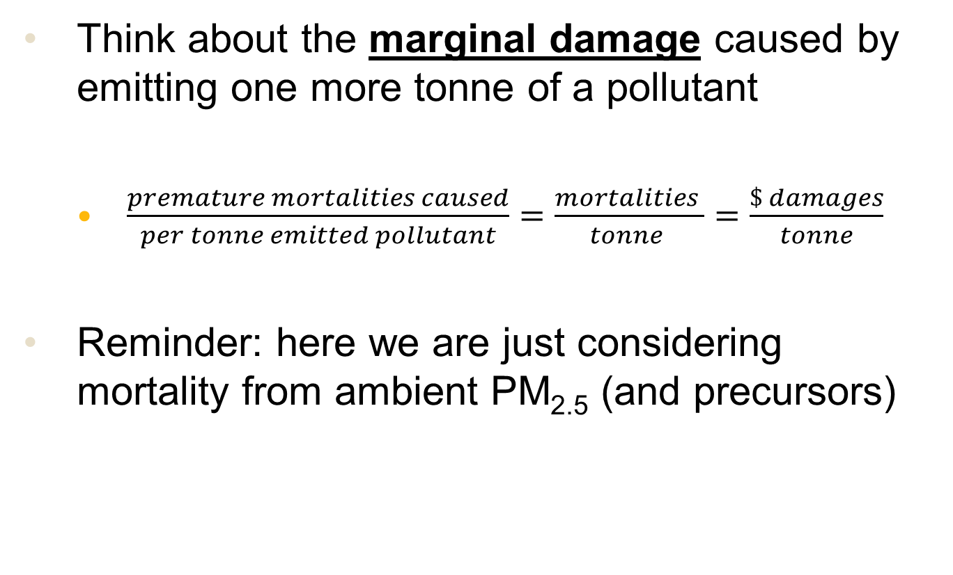
Air Pollution Impact Metrics
Think about the marginal damage caused by emitting one more tonne of a pollutant
$\frac{premature mortalities caused}{per tonne emitted pollutant}=\frac{mortalities }{tonne }=\frac{\$ damages}{tonne}$
Reminder: here we are just considering mortality from ambient PM_{2.5} (and precursors)

Slide 7
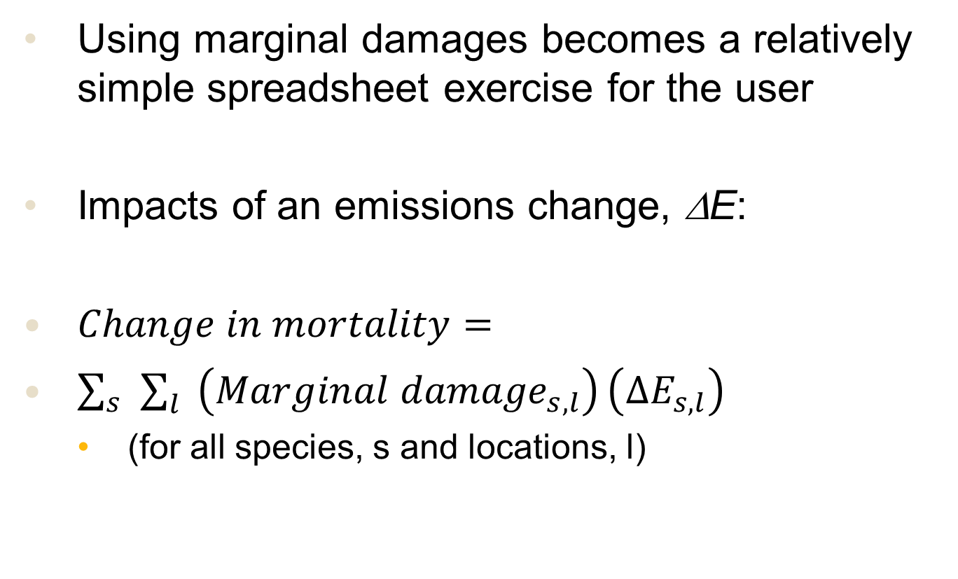
RCMs Use #1: Assessing Damages
Using marginal damages becomes a relatively simple spreadsheet exercise for the user
Impacts of an emissions change, ΔE:
$Change in mortality=$
$\sum_{s}{\sum_{l}{\left({Marginal damage}_{s,l}\right)}\left({∆E}_{s,l}\right)}$
(for all species, s and locations, l)

Slide 8
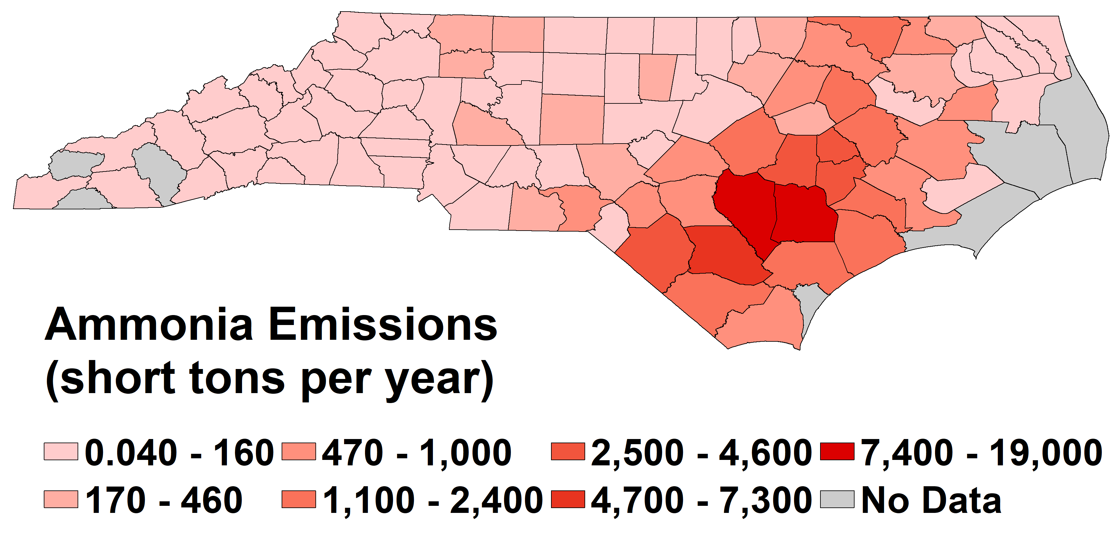
Sample Calculation
What are damages associated with swine production in NC?
(tons/yr)
NEI2011 projected to 2017 / SCC 2805039000

Slide 9
Spreadsheet Analysis
 |  |  | Total mortalities per year | 1331
County Name | County fips code | NH3 damages (mortalities/tonne) | Livestock NH3 emissions (tons/year) | Mortalities (per year)
Alamance | 37001 | 0.0118 | 0 | 0
Alexander | 37003 | 0.0107 | 1263 | 14
Alleghany | 37005 | 0.0088 | 0 | 0
Anson | 37007 | 0.0091 | 2959 | 27
Ashe | 37009 | 0.0091 | 0 | 0
Avery | 37011 | 0.0100 | 0 | 0
Beaufort | 37013 | 0.0062 | 807 | 5
Bertie | 37015 | 0.0075 | 1698 | 13
Total mortalities from emissions in all counties (sum of column)
Mortalities caused by emissions in that county
= (marginal social damage)
x (emissions)
…other counties (100 total)
Marginal social damage (mortalities/tonne) from RCM
Emissions inventory

Slide 10
RCMs Use #2: Source-Receptor
If you want spatially resolved output, things are only slightly harder
Divide your country/region into locations:
Regular Cartesian grid or municipalities
Locations = (l₁, l₂, l₃, … l_{N})
E.g. locations may be a list of countries*
Locations = (Angola, Botswana, Eswatini, Lesotho, Malawi, Mozambique, Namibia, South Africa, Zambia, Zimbabwe)
*short example: generally, RCMs are much higher resolution

Slide 11
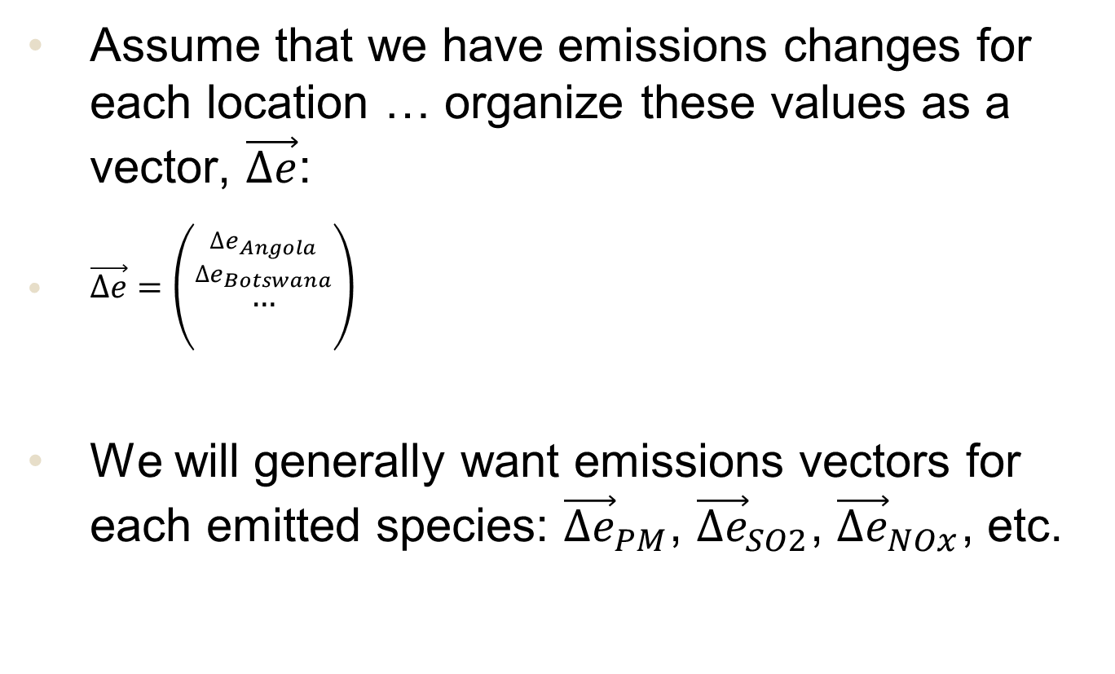
RCMs Use #2: Source-Receptor
Assume that we have emissions changes for each location … organize these values as a vector, $\vec{∆e}$:
$\vec{∆e}=\left(\begin{aligned}\begin{aligned}{{∆e}_{Angola} \atop {∆e}_{Botswana}} \\ …\end{aligned} \\ \end{aligned}\right)$
We will generally want emissions vectors for each emitted species: ${\vec{∆e}}_{PM}$, ${\vec{∆e}}_{SO2}$, ${\vec{∆e}}_{NOx}$, etc.

Slide 12
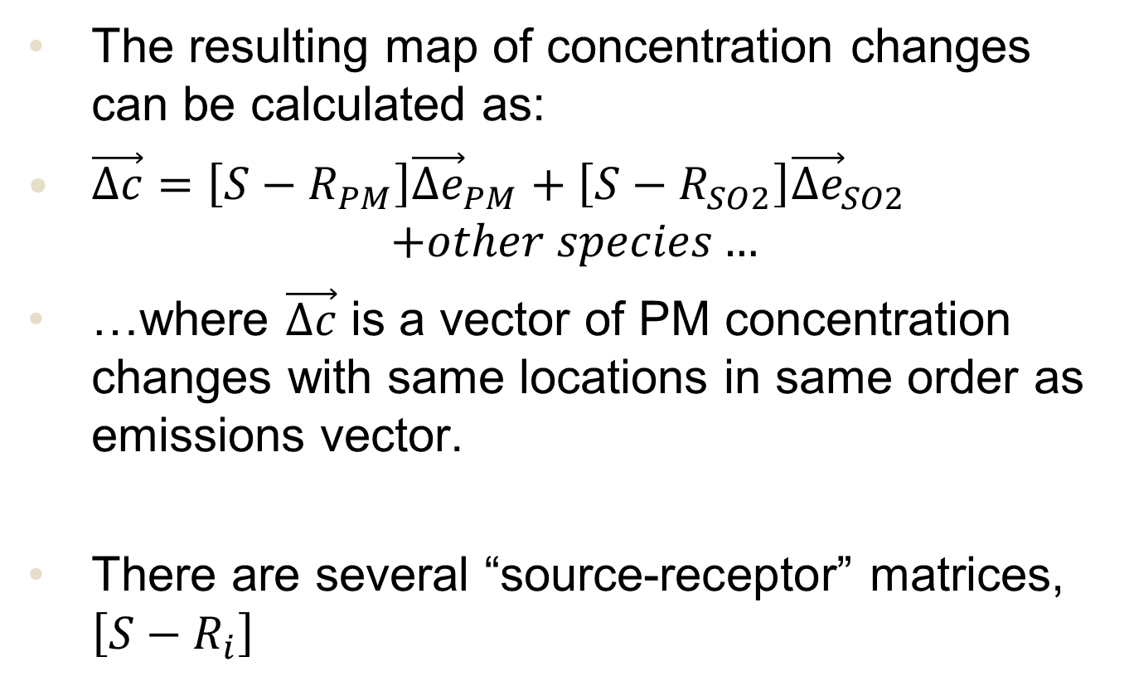
RCMs Use #2: Mapping Changes
The resulting map of concentration changes can be calculated as:
$\vec{∆c}=\left[{S−R}_{PM}\right]{\vec{∆e}}_{PM}+\left[{S−R}_{SO2}\right]{\vec{∆e}}_{SO2}$
$$+other species…$$
…where $\vec{∆c}$ is a vector of PM concentration changes with same locations in same order as emissions vector.
There are several “source-receptor” matrices, $\left[{S−R}_{i}\right]$

Slide 13
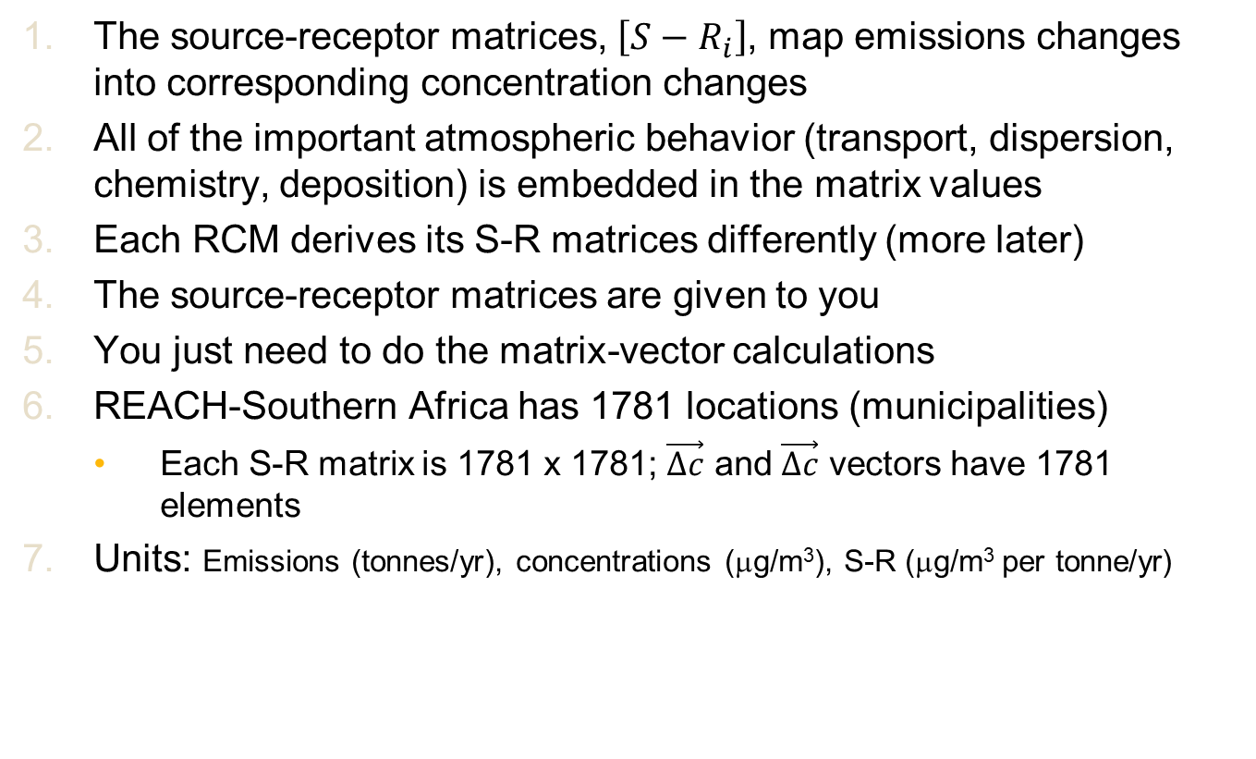
Source-Receptor Matrices
The source-receptor matrices, $\left[{S−R}_{i}\right]$, map emissions changes into corresponding concentration changes
All of the important atmospheric behavior (transport, dispersion, chemistry, deposition) is embedded in the matrix values
Each RCM derives its S-R matrices differently (more later)
The source-receptor matrices are given to you
You just need to do the matrix-vector calculations
REACH-Southern Africa has 1781 locations (municipalities)
Each S-R matrix is 1781 x 1781; $\vec{∆c}$ and $\vec{∆c}$ vectors have 1781 elements
Units: Emissions (tonnes/yr), concentrations (μg/m³), S-R (μg/m³ per tonne/yr)

Slide 14
RCMs: Really three different things…
RCM developers
RCM users
“Very easy”: ~1 hour with spreadsheet
Reduced-complexity model
(several different methods)
Marginal damages
(mortalities or $ per tonne emitted)
Source-receptor matrix
(how emissions at location X impact concentrations at location Y)
“Moderately easy”: few hours in programming environment (R, Python, etc.)

Slide 15
Concentration-Response Function
Premature mortality from chronic (annual-average) PM2.5 exposure
American Cancer Society (ACS) cohort
6% increase in mortality per 10 μg m⁻³
Harvard 6-Cities
14% increase in mortality per 10 μg m⁻³
Additional mortality
Baseline mortality
Concentration change
Relative risk

Slide 16
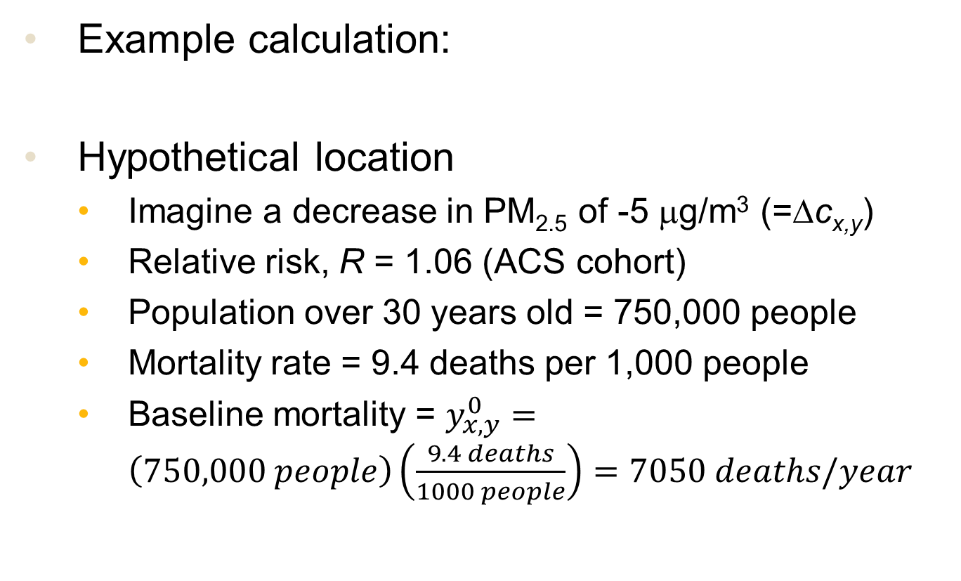
Concentration-Response Function
Example calculation:
Hypothetical location
Imagine a decrease in PM_{2.5} of -5 μg/m³ (=Δc_{x,y})
Relative risk, R = 1.06 (ACS cohort)
Population over 30 years old = 750,000 people
Mortality rate = 9.4 deaths per 1,000 people
Baseline mortality = $y_{x,y}^{0}=\left(750,000 people\right)\left(\frac{9.4 deaths}{1000 people}\right)=7050 deaths/year$

Slide 17
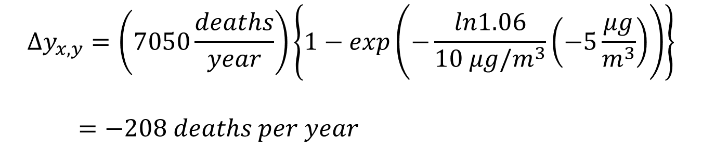
Concentration-Response Function
Example calculation:
$$∆y_{x,y}=\left(7050\frac{deaths}{year}\right)\left\{1−exp\left(−\frac{ln1.06}{10 μg/m^{3}}\left(−5\frac{μg}{m^{3}}\right)\right)\right\}$$
$=−208 deaths per year$

Slide 18
Cost-Effectiveness Analysis
Idea: prioritize emissions reductions that bring most benefit for least cost
Needs:
Number of lives saved (from RCM)
Implementation cost of the policy ($)
The cost-effectiveness metric is the ratio:
Lower cost (per life saved) is better
$$Cost−effectiveness= \frac{\$ implementation cost (\$)}{lives saved}$$

Slide 19
Conclusion
That was a very fast overview of key ideas about RCMs
Hopefully, that lets you:
look at or try some of the simpler problems
come to the workshop with foundational knowledge
Don’t worry: we will go over this all again
I am looking forward to meeting you all

